Slide 1
Chapter 7 – Degradation of Biomaterials

Slide 2
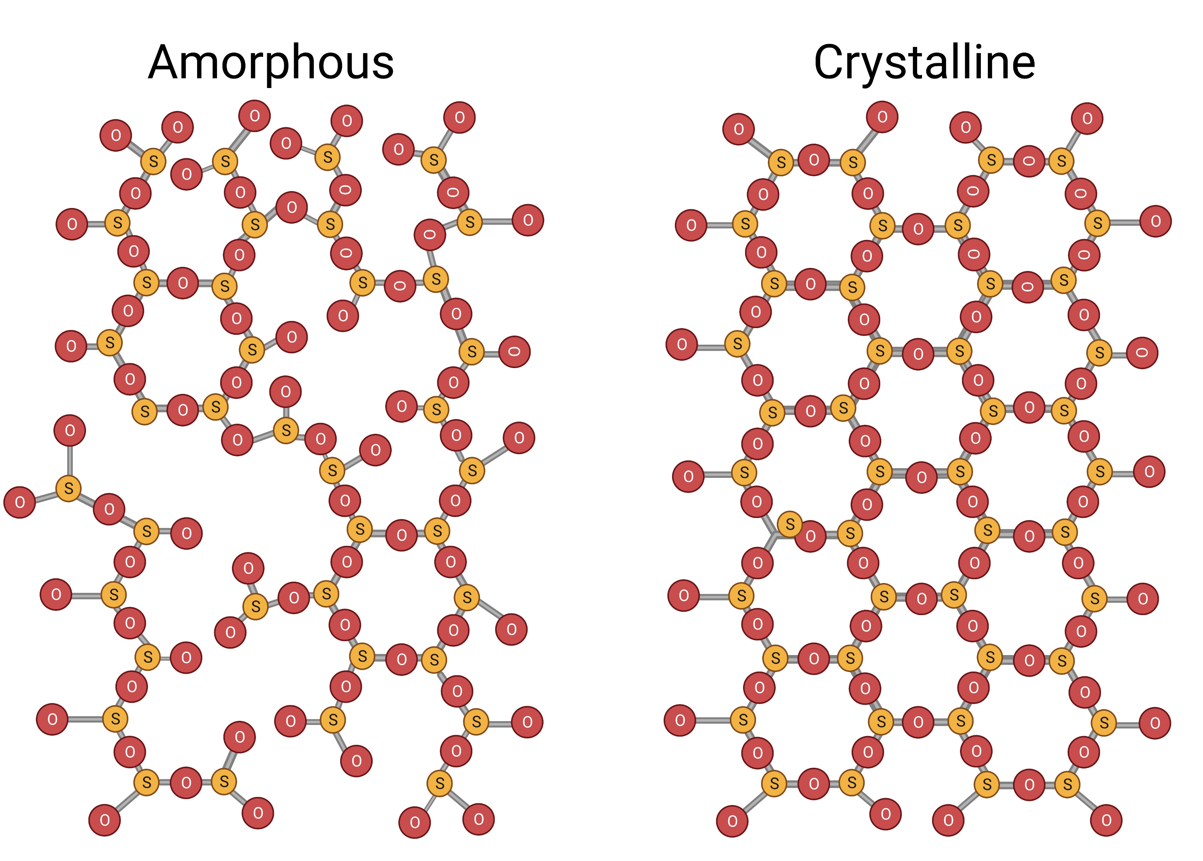
Notes:
Figure 7.1: Amorphous and Crystalline Structures of SiO₂ (Note: the fourth oxygen for each tetrahedra is not shown).
Created with Biorender.com.

Slide 3
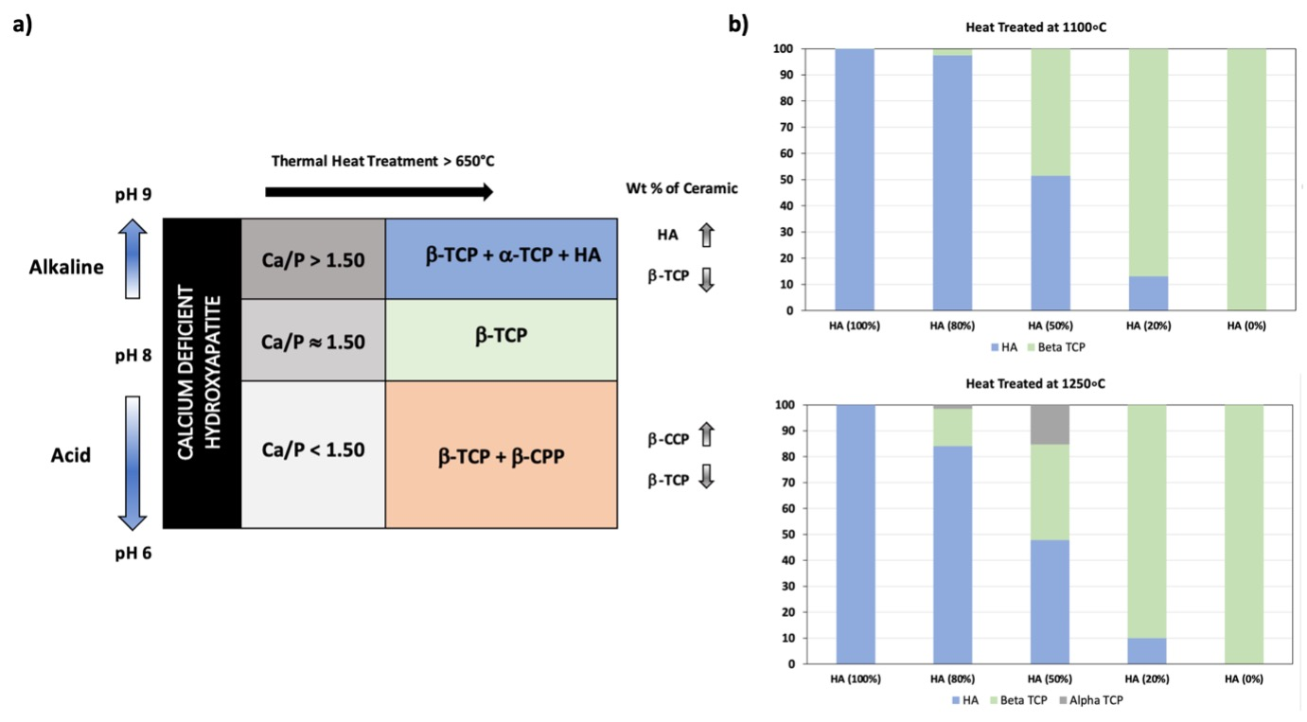
Notes:
Figure 7.2: a) Schematic representation of the influence of the synthesis pH on the Ca/P molar ratio of calcium deficient hydroxyapatite (CDHA). b) Shows Rietveld refinement quantitative analysis of X-ray powder diffraction.
Adopted from Chemically pure β-tricalcium phosphate powders: Evidence of two crystal structures. Le Gars Santoni, B. et al. J. Eur. Ceram. Soc. (2021).

Slide 4
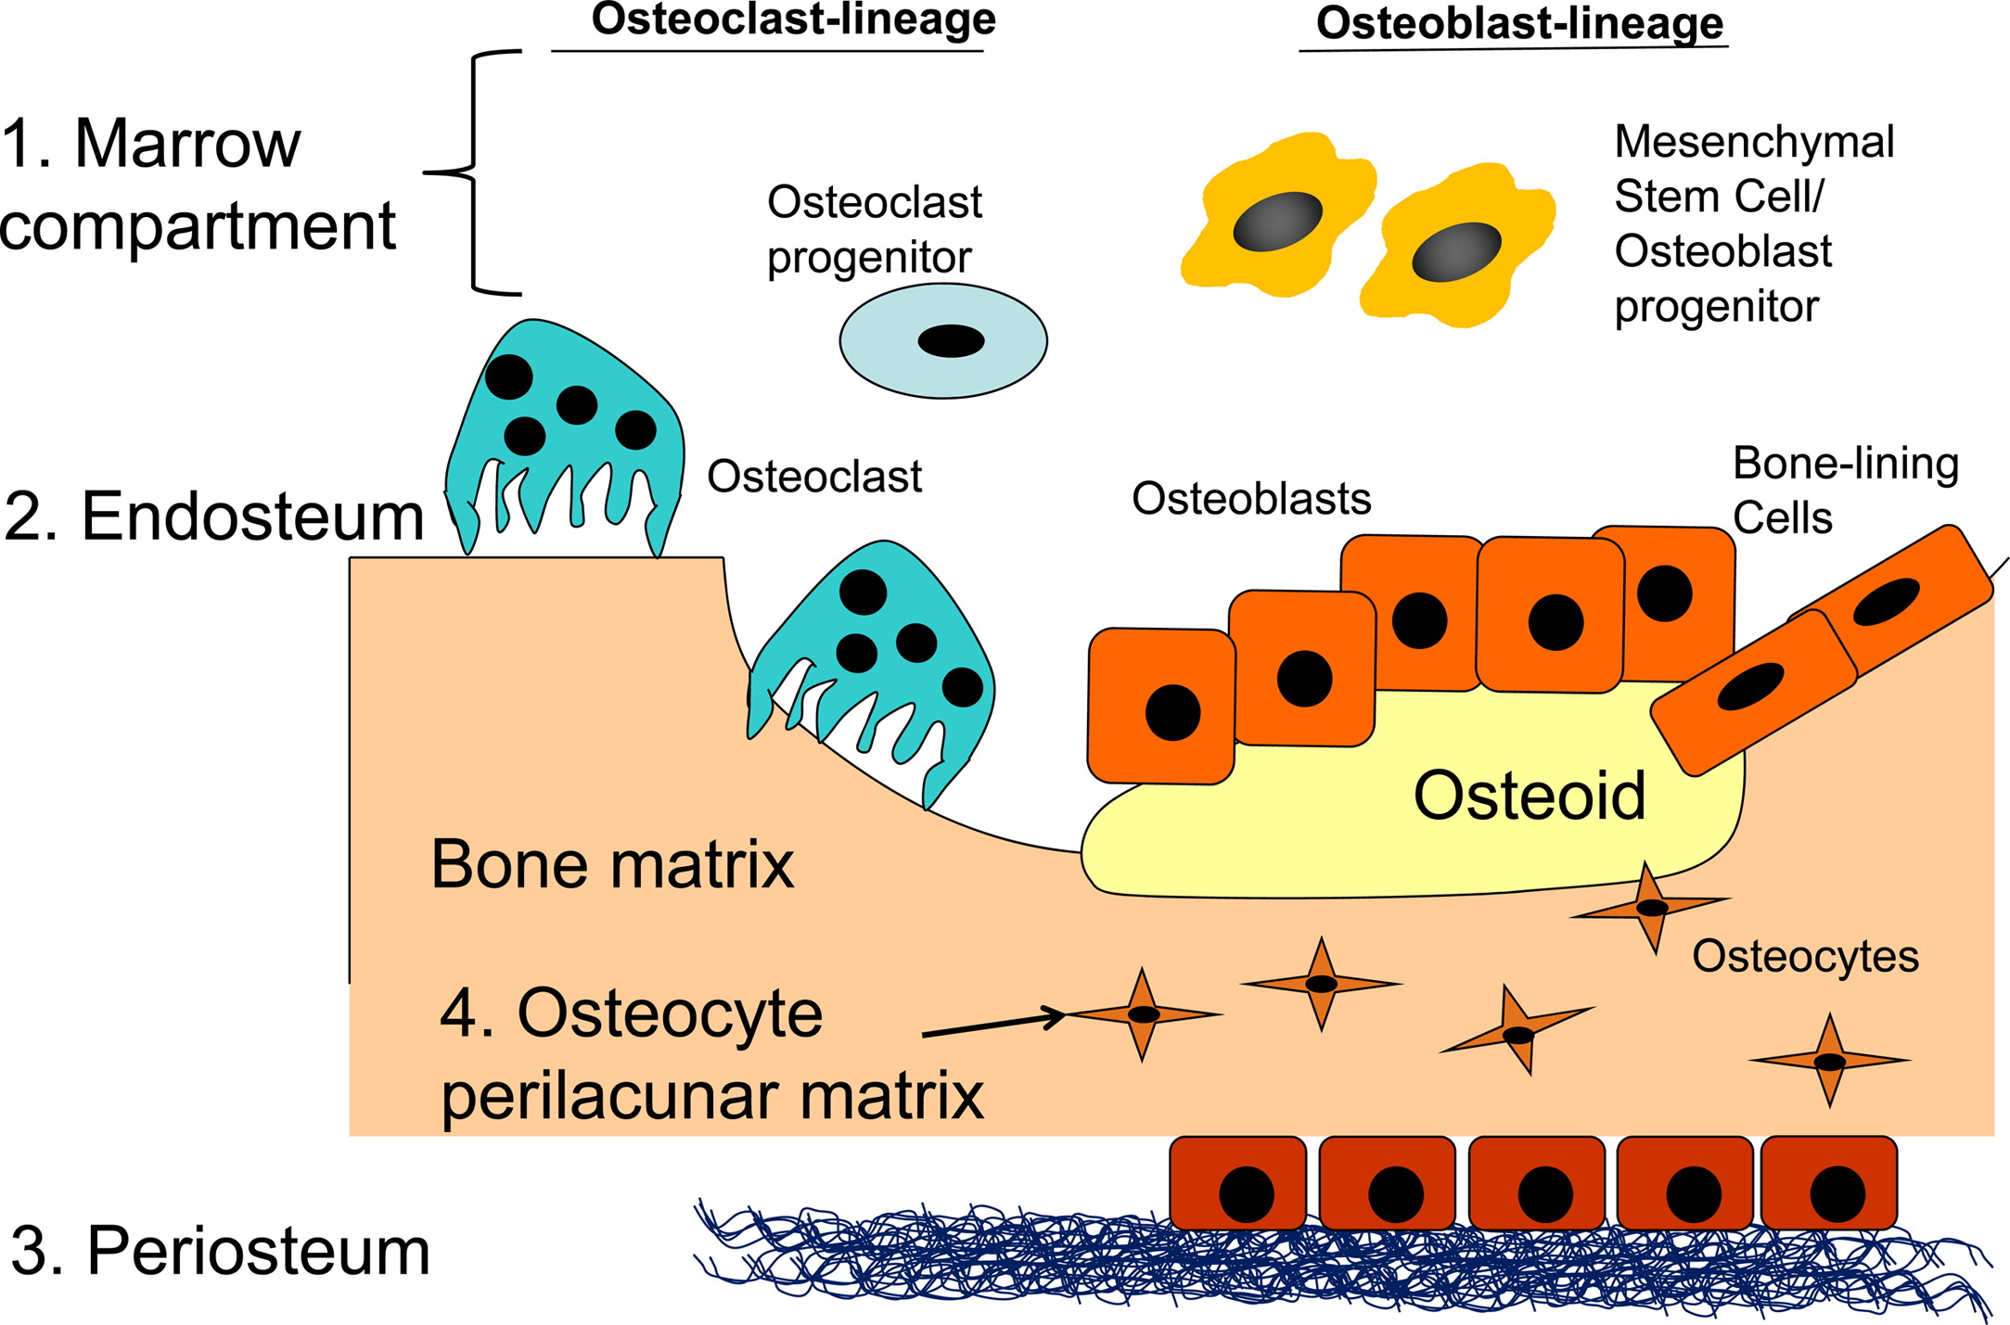
Notes:
Figure 7.3: Overview of the cells involved in bone remodeling and the matrix compartments of bone.
From Extracellular matrix networks in bone remolding, Alford, Kozloff and Hankenson, 2015.

Slide 5
Notes:
Figure 7.4: a) Solubility isotherms of calcium phosphates at 37°C. b) Solubility isotherms of salts in solution as a function of the pH. This diagram represents the three different saturation states of an ionic solution susceptible to precipitation.
From ‘Structure and chemistry of the apatites and other calcium orthophosphates’, Studies in Organic Chemistry. Elliott, J. C., 1994.

Slide 6
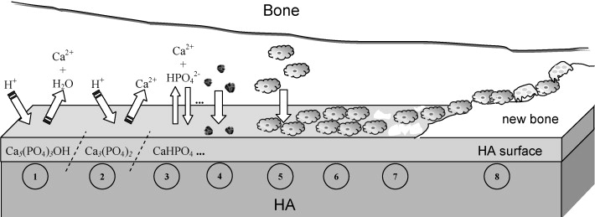
Notes:
Figure 7.5: Interactive in vivo of interactions at the surface of the biomaterial.
From Hydroxyapatite surface solubility and effect on cell adhesion, Bertazzo et al., 2010, Colloids and Surfaces B: Biointerfaces. Elsevier B.V., 78(2), pp. 177–184.

Slide 7
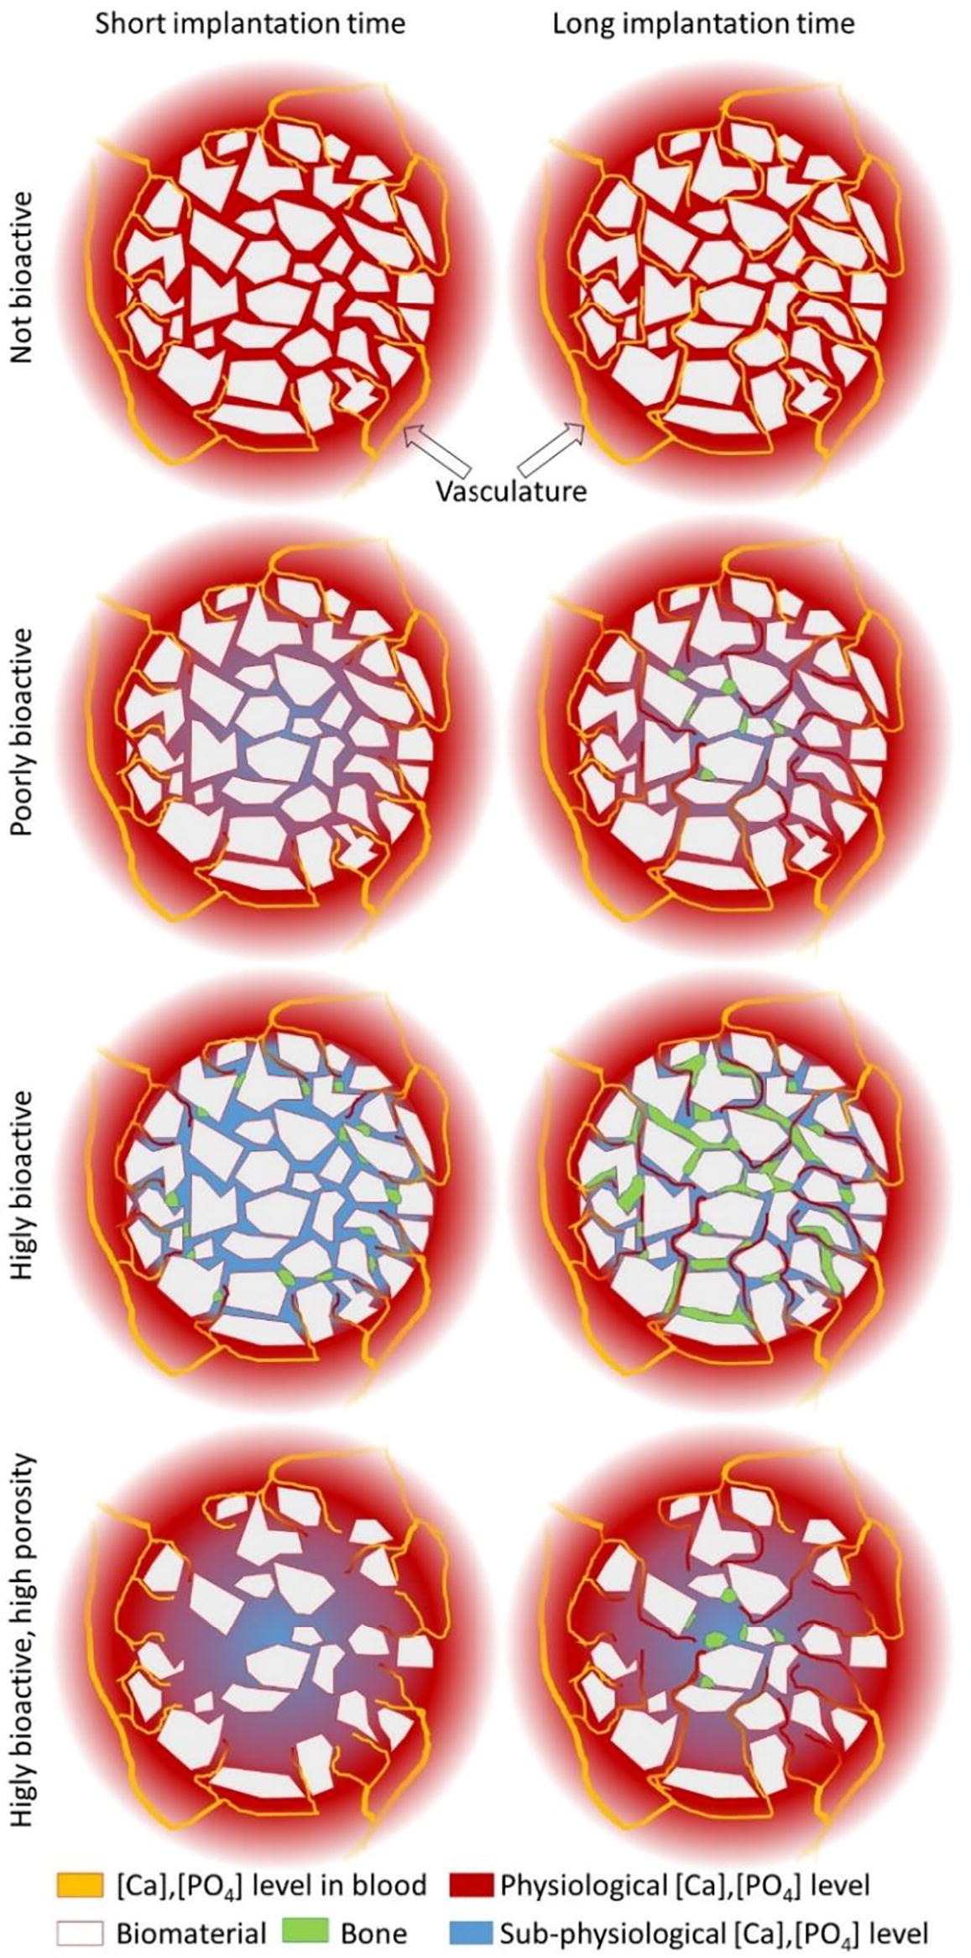
Notes:
Figure 7.6: Schematic showing blood vessel ingrowth and heterotopic bone formation in bone substitutes.
From A proposed mechanism for material-induced heterotopic ossification, Bohner and Miron, 2019, Materials Today. The Authors, 22(February), pp. 132–141.

Slide 8
Notes:
Figure 7.7: Light microscopy pictures of macroporous CaPs implanted in goat’s femoral condyle (magnification: 2×).
Courtesy of Dr. Huipin Yuan.

Slide 9
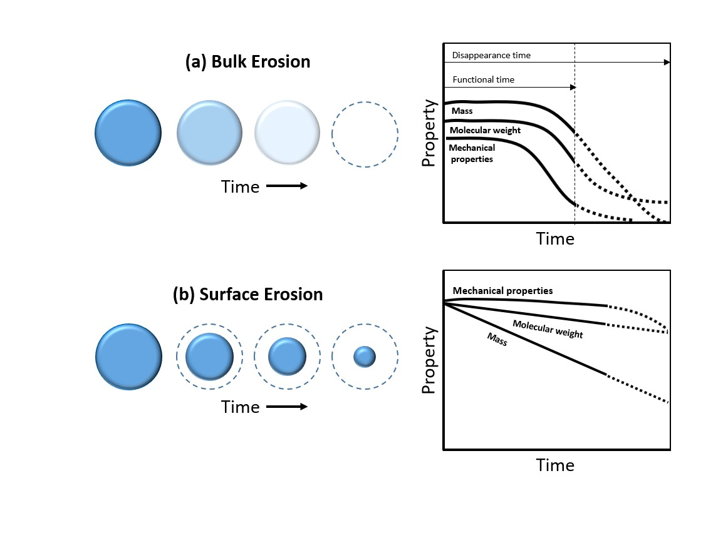
Notes:
Figure 7.8: Representation of the bulk and surface erosion processes of biodegradable polymers.

Slide 10
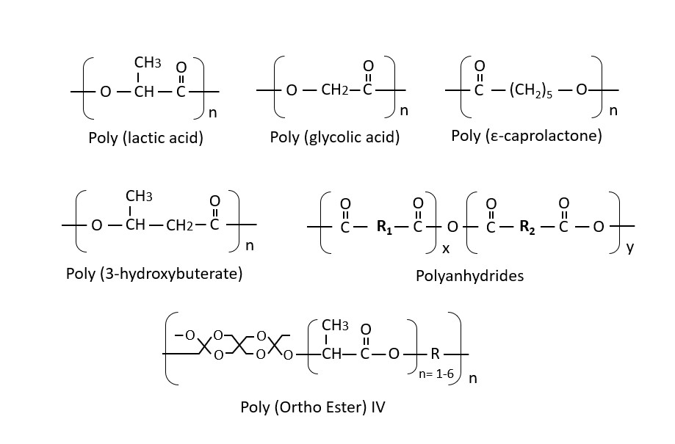
Notes:
Figure 7.9: Chemical structures of commonly used bioabsorbable polymers.

Slide 11
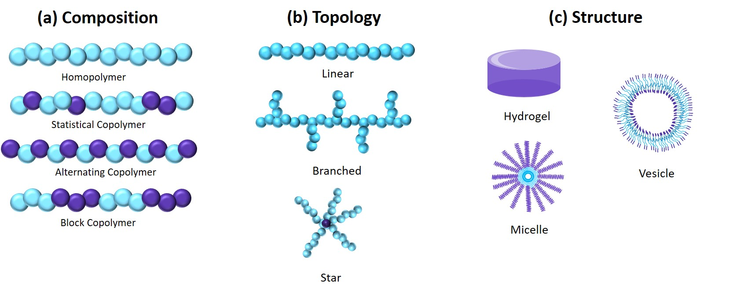
Notes:
Figure 7.10: Various polymer. a) Compositions. b) Topologies. c) Architecture.

Slide 12
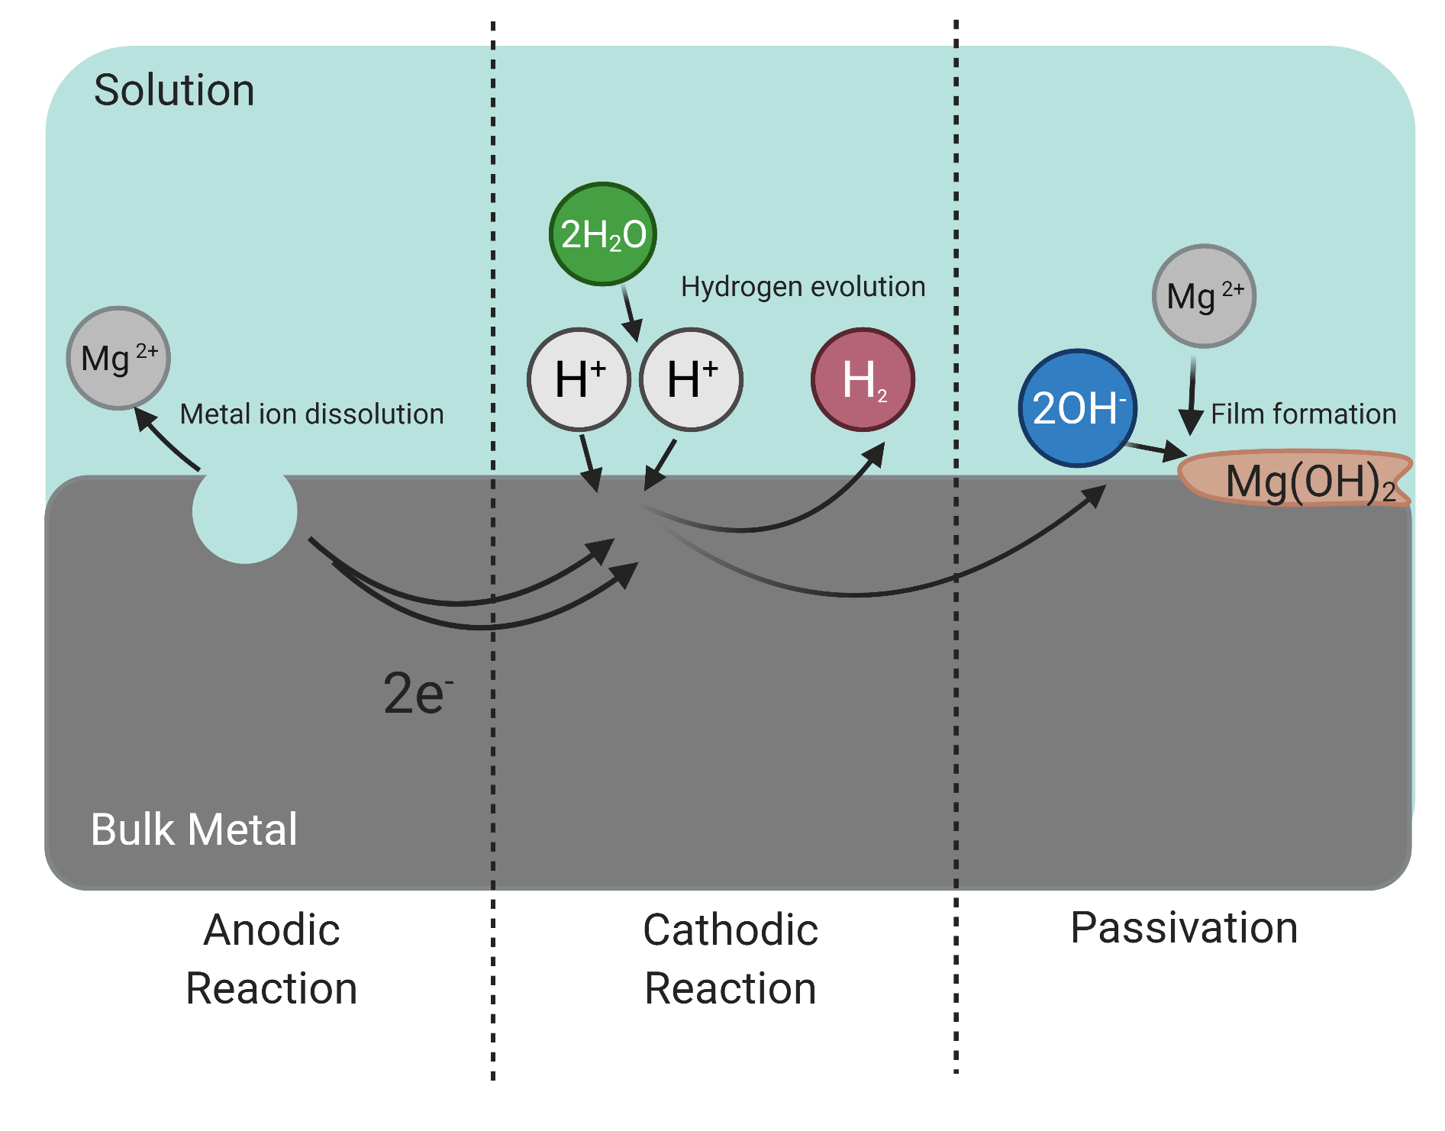
Notes:
Figure 7.11: An example of the corrosion process of pure magnesium in a neutral solution.
Created with biorender.com.

Slide 13
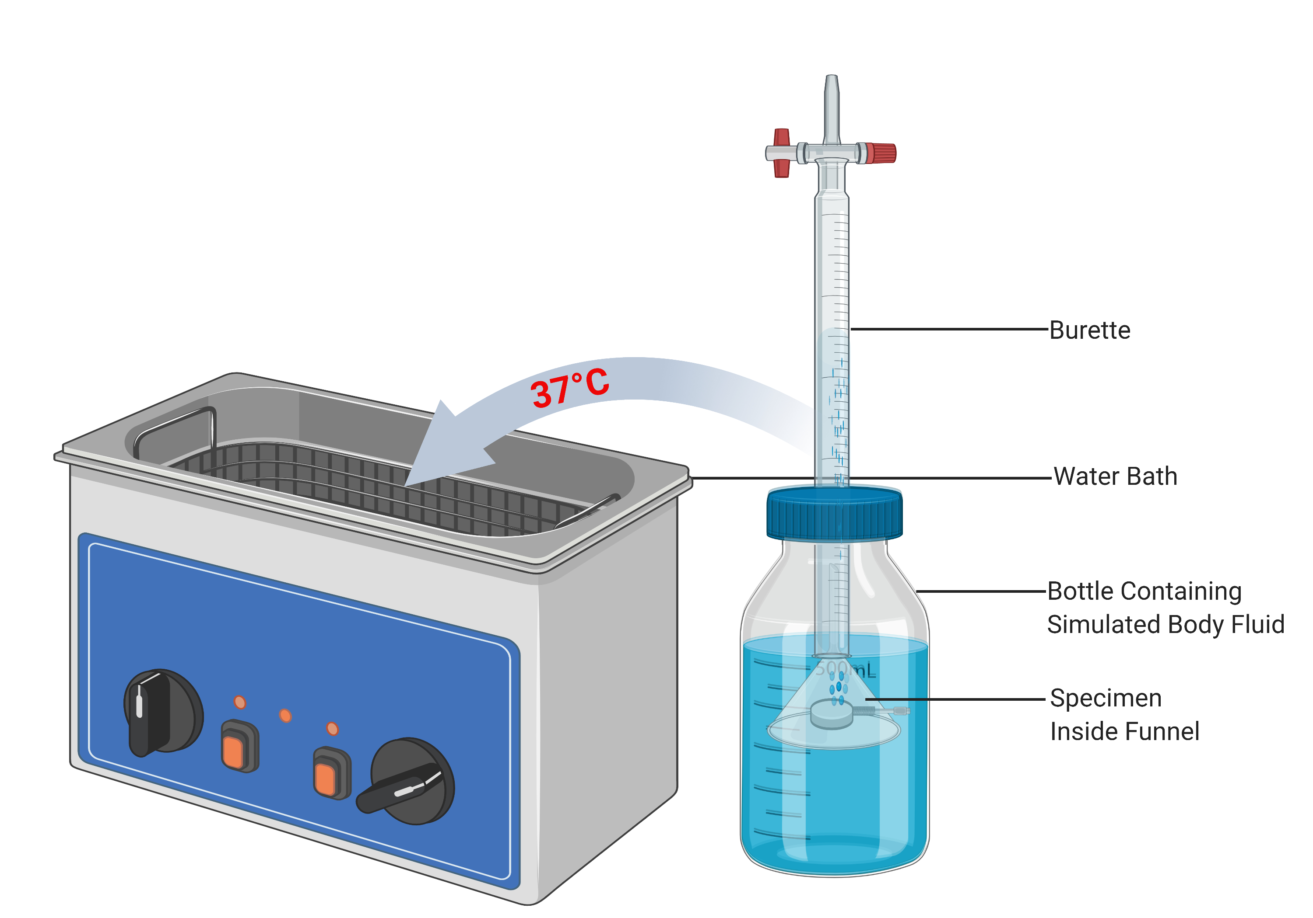
Notes:
Figure 7.12: Schematic example of an experimental set up for the physiological assessment of hydrogen evolution from magnesium alloys.
Created with biorender.com.

Slide 14
Notes:
Figure 7.13: Bone tissue formation in excavated bioactive glass particles of narrow size range. Bone tissue is stained red. Also note the channels connecting the interior of the particle with the surrounding milieu.
From Bioactive ceramics: The effect of surface reactivity on bone formation and bone cell function, Ducheyne & Qiu, Biomaterials (1999).

Slide 15
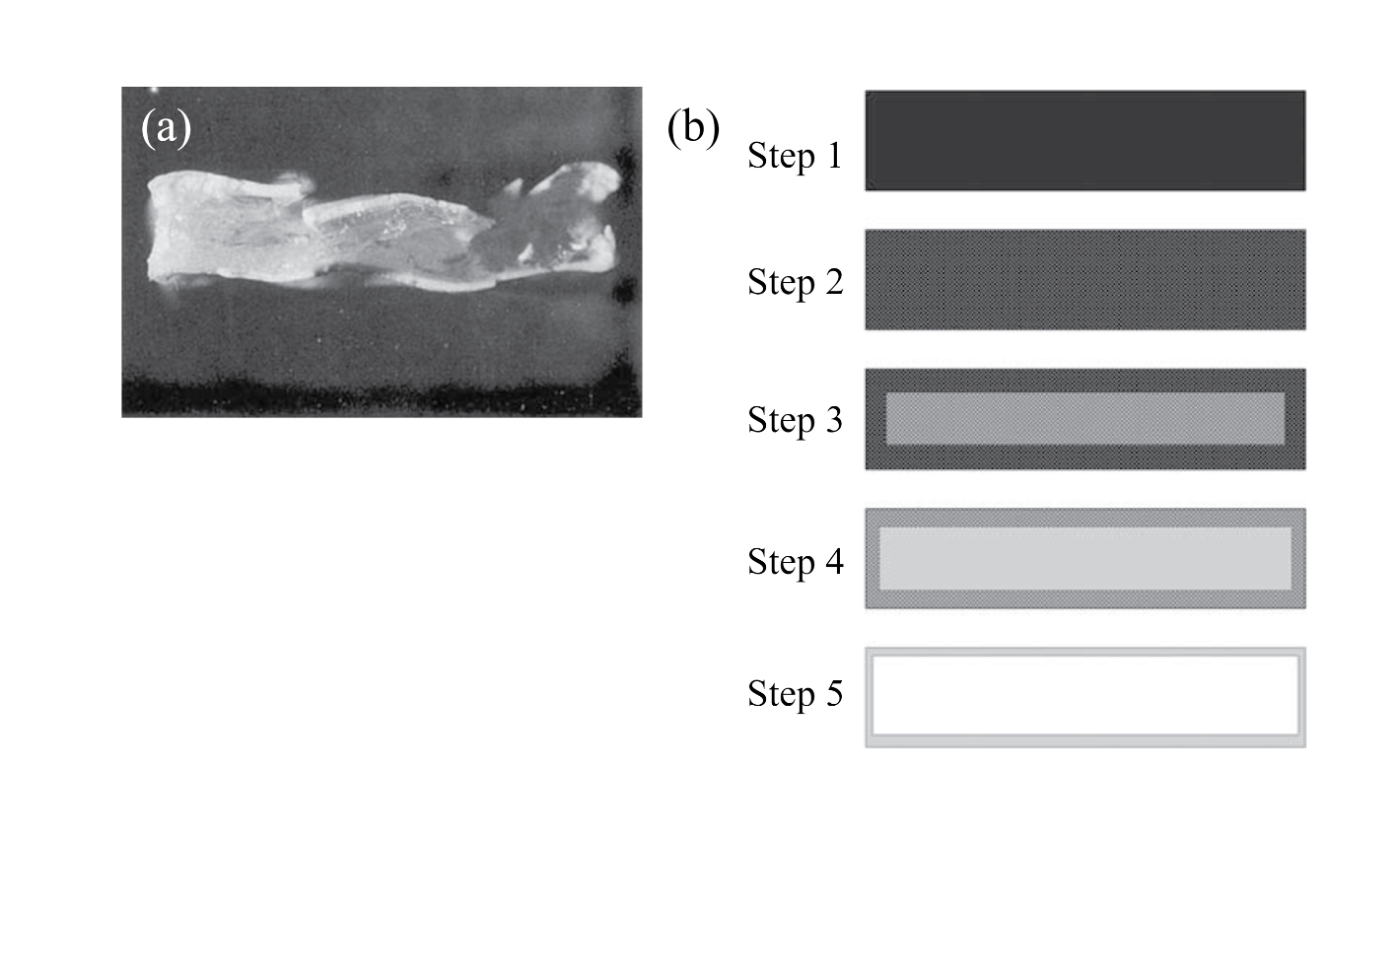
Notes:
Figure 7.14: a) Cross-section of a PDLLA specimen degraded for 5 weeks in saline buffer. b) Schematic representation of the different steps of the degradation of PDLLA specimens in aqueous medium. Step 1: initial specimen; Step 2: water absorption, start of ester bond cleavage, and decrease in molecular weight; Step 3: differentiation between surface and center, with dramatic decrease in molecular weight in inner part of the specimen; Step 4: diffusion of oligomers through thinning surface when molecular weight is low enough to allow solubilization in the medium; Step 5: hollow shell remaining after release of oligomers and slow degradation of the shell.
From Structure-property relationships in the case of the degradation of massive poly (a-hydroxy acids) in aqueous media. Li et al., 1990. J. Mater. Sci. Mater. Med. 1, 198.

Slide 16
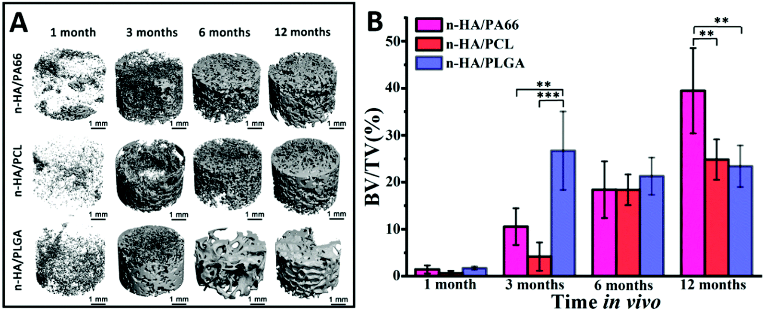
Notes:
Figure 7.15: The 3D micro-CT reconstructed images of new bone tissue (a), and the quantitative BV/TV value (b) for the three scaffolds at 1, 3, 6 and 12 months after implantation.
From The long-term behaviors and differences in bone reconstruction of three polymer-based scaffolds with different degradability, Huang et al., 2019, Mater. Chem. B, 7, 7690.

